Slide 1

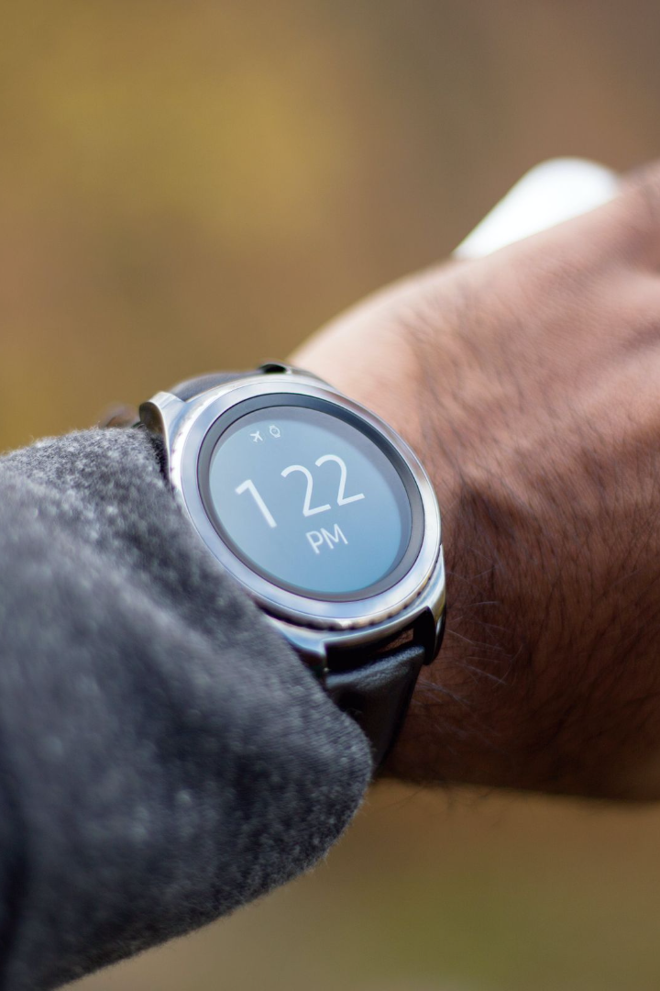
Smart Watch System
A revolutionary DBMS project that integrates wearable technology and efficient data management for patient vitals.

Slide 2
Features of the Smart Watch System
Real-Time Monitoring ⌚️
Immediate Notification To Doctor 🏃‍♂️
Track vital signs such as heart rate, blood pressure, and oxygen levels in real-time for accurate health monitoring.
Record and analyze physical activity data to help users achieve their fitness goals.
Quick Ambulance Arrival
Medicine Reminder
Receive timely notifications and alerts about medication reminders, appointments, and abnormal health readings.
Aesthetically pleasing smart watch designs that blend fashion with technology, suitable for any occasion.

Slide 3

Efficient Patient Vitals Data Management
1
Automated Reports 📊
Generate automated reports summarizing patient vitals trends and anomalies, facilitating medical diagnosis.
Data Analytics 📈
2
Leverage advanced analytics to gain insights from patient vitals data, contributing to personalized healthcare.

Slide 4
System Architecture

Slide 5

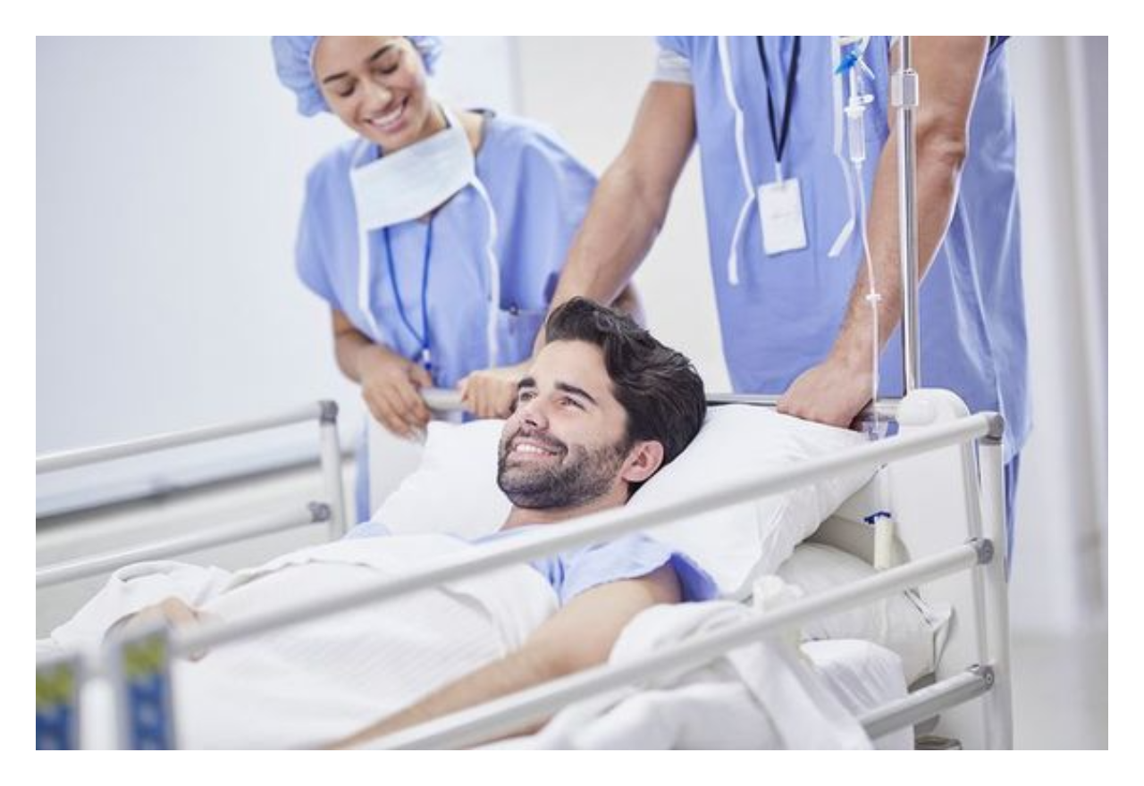
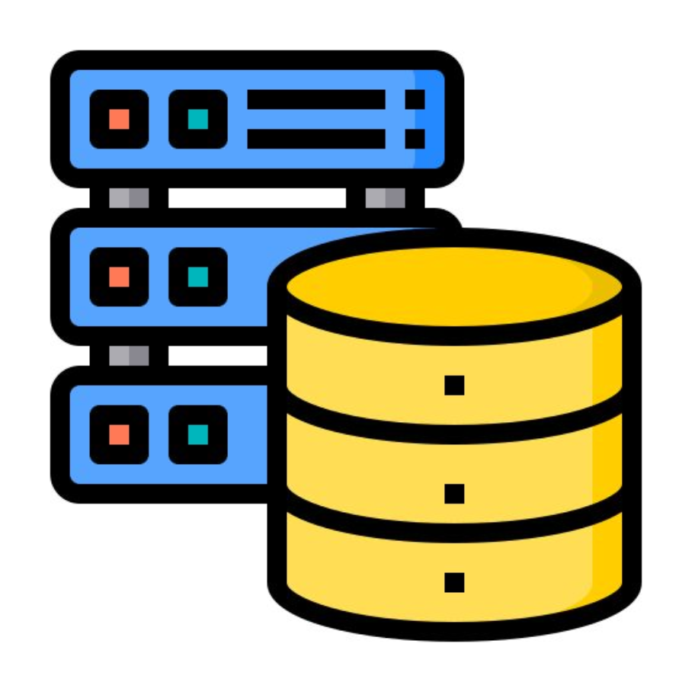
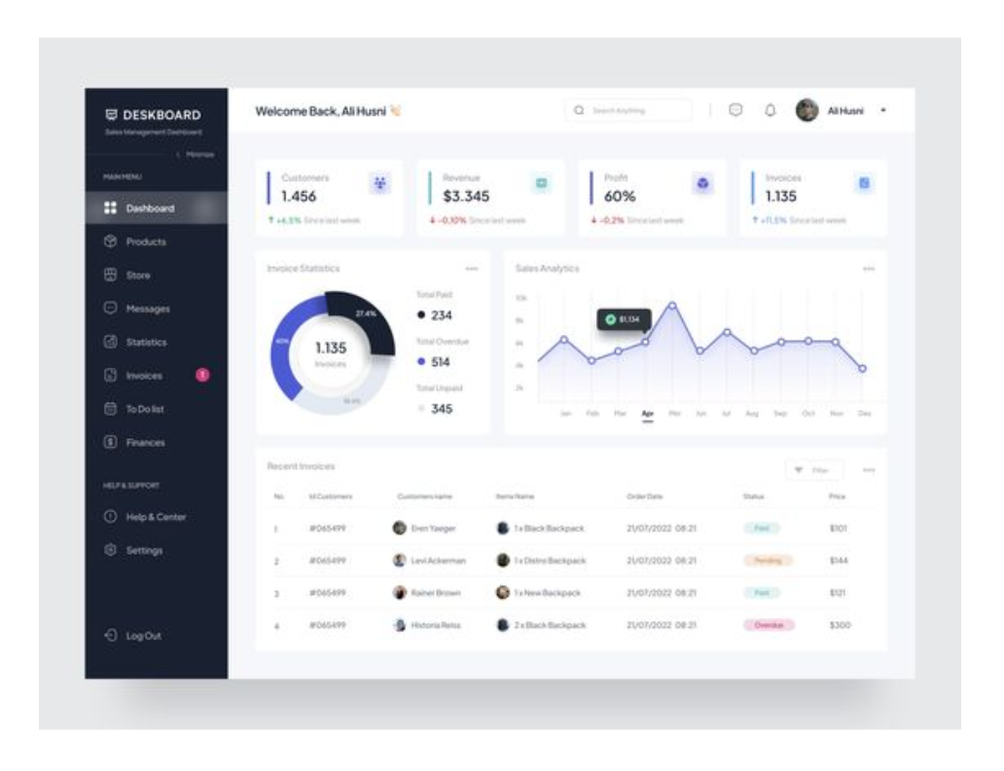
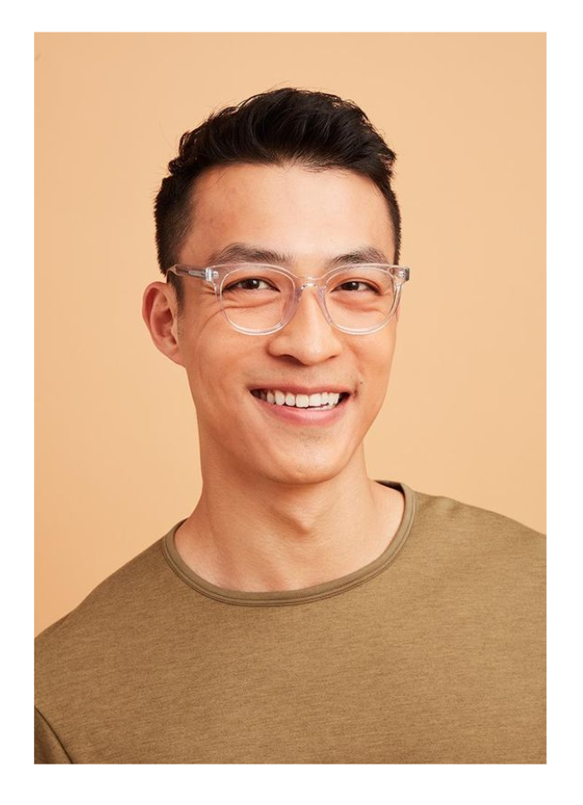
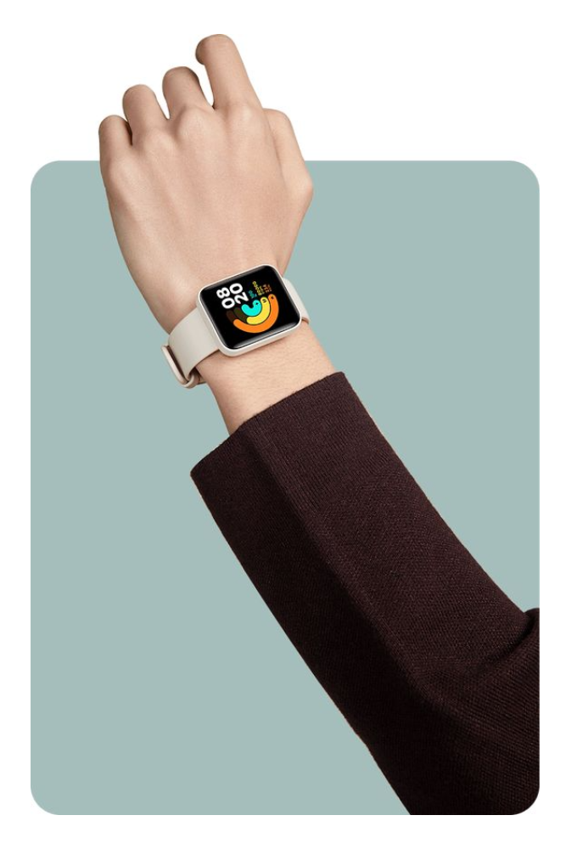
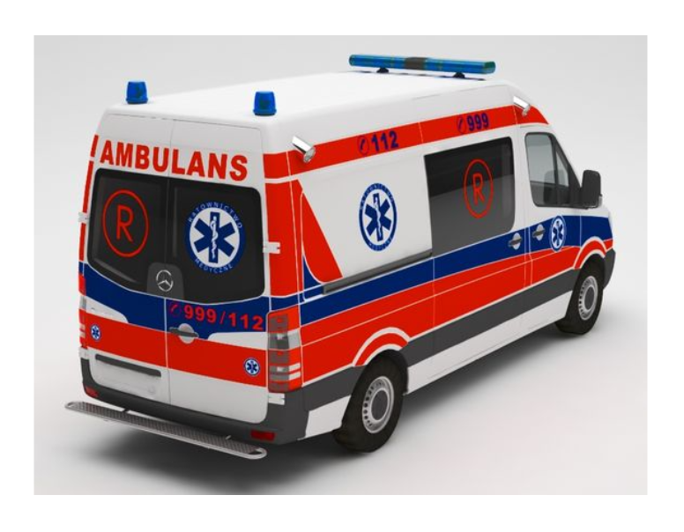
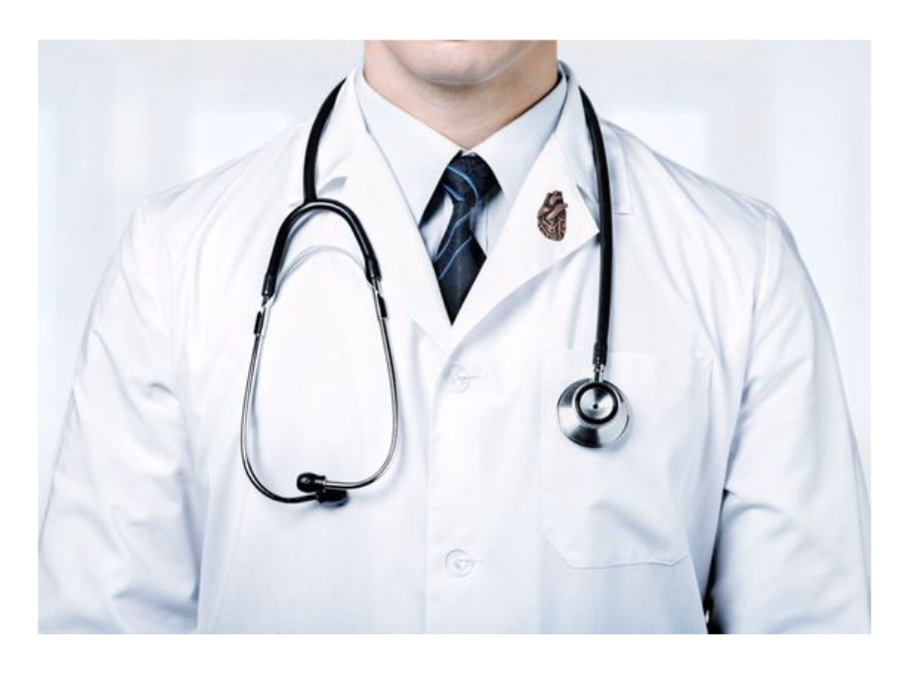
Hospital
Patient’s old data
Patient
MySSQL
Dashboard
Real Time Vitals
Ambulance
Doctor

Slide 6
Logical Model

Slide 7
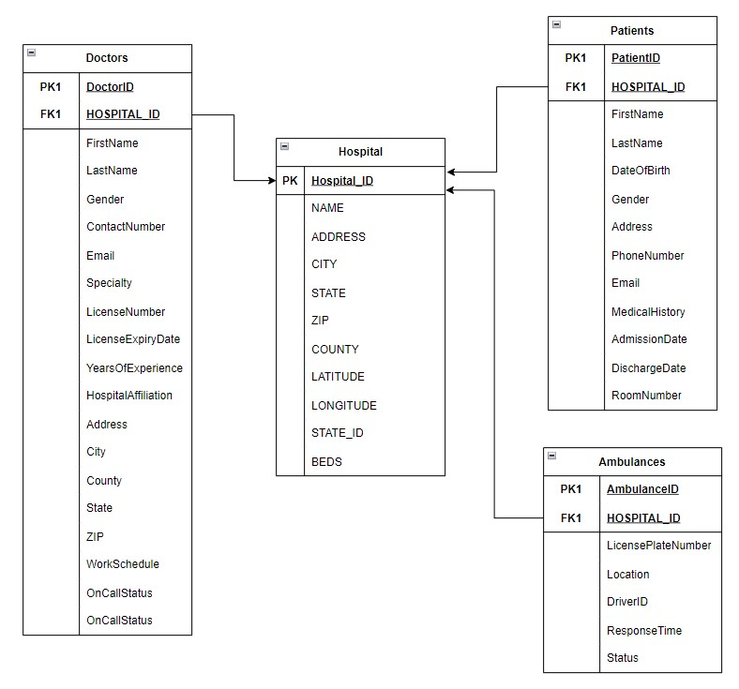

Slide 8
Conceptual Model

Slide 9
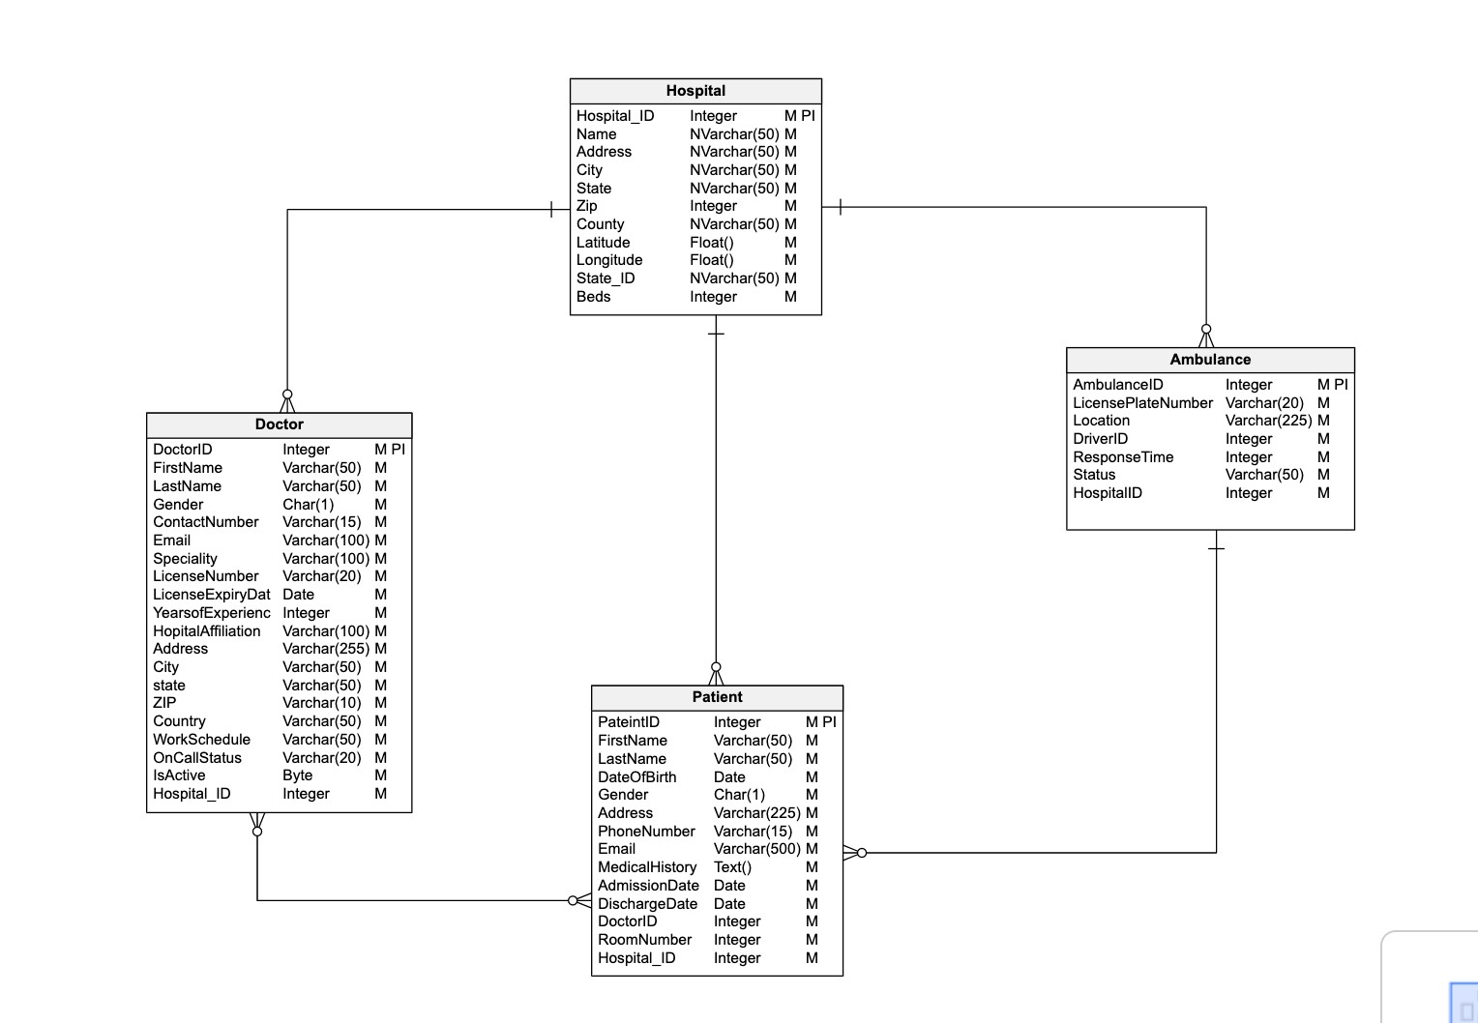

Slide 10
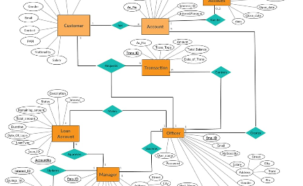

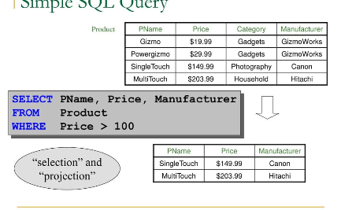
Database Design for the Smart Watch System
Optimized Data Model
Data Normalization
Query Optimization
An optimized database design that efficiently stores and manages patient vitals data for quick retrieval and analysis.
Utilizes data normalization techniques to minimize redundancy and improve data integrity within the database.
Efficiently optimizes database queries to ensure fast and accurate retrieval of patient vitals data.

Slide 11
User Interface and Functionality
Intuitive Interface 📲
Customizable Settings ⚙️
Compatibility 🔄
Provides a user-friendly interface with intuitive navigation for easy access to smart watch features and health data.
Compatible with multiple platforms, ensuring widespread accessibility and seamless integration with existing healthcare systems.
Allows users to personalize their experience by customizing settings such as display preferences and notification preferences.

Slide 12

Future Developments and Enhancements
1
Artificial Intelligence Integration
Implement AI algorithms to analyze patient vitals data and provide personalized health recommendations and alerts.
Extended Health Tracking
2
Expand health tracking capabilities to include additional metrics and insights for a comprehensive health monitoring experience.
3
Enhanced User Experience
Continuously improve the user interface and functionality based on user feedback and evolving technological advancements.

